Slide 1







OPSNEXUS
A unified operations intelligence layer for data pipelines, data trust, requests, and platform cost.
VISIBLE
TRUSTED
ACTIONABLE
EXATHON 2026
Team Nexus
TRACK - 4
WORK BEHIND THE WORK
Presented By:

Slide 2
01 / PROBLEM STATEMENT
Operational work is invisible until something breaks
Internal teams lose time connecting signals scattered across pipelines, quality checks, requests, and spend.
01
PIPELINES FAIL SILENTLY
02
DATA TRUST
Failures and delays can go unnoticed until downstream workflows are affected.
Users see metrics, but cannot quickly verify freshness, rejected rows, or quality status.
03
DATA REQUESTS STALL
04
COST OUTRUNS USAGE
Finding the right table, understanding its schema, and routing requests depend on manual help.
Spending is difficult to interpret without operational usage context.
THE ROOT CAUSE Fragmented operational signals → delayed diagnosis → low confidence → avoidable manual work
02

Slide 3
02 / SOLUTION
One console. Four operational modules.
OpsNexus turns scattered operational details into role-specific answers and next actions.
PIPELINE WATCH
DETECT
DATA TRUST
VERIFY
Monitor runs, detect failures, and inspect execution details.
Evaluate quality results, freshness, and valid/invalid records.
REQUEST HUB
UNBLOCK
COST LENS
OPTIMIZE
Discover datasets and organize structured data requests.
Explore cost trends and connect spending with operational context.
OPERATING LOOP Observe → Investigate → Decide → Improve
03

Slide 4
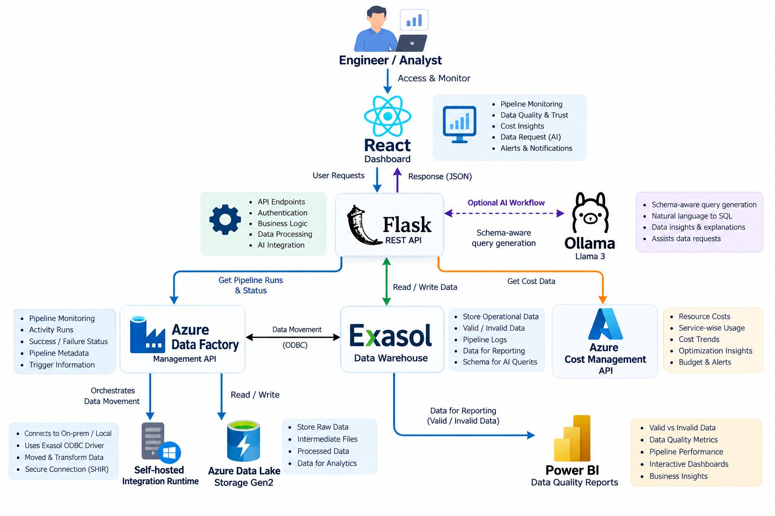
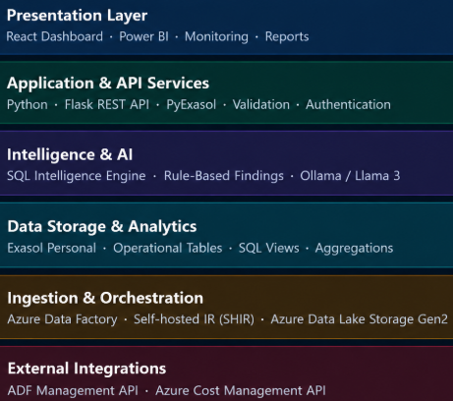
03 / SYSTEM ARCHITECTURE
A thin service layer. A strong analytical core.
Exasol stores and serves the unified operational dataset; source platforms remain authoritative for their own records.
Failure path: source event → persisted run status → API response → dashboard alert. If a source API is unavailable, show a clear degraded state and last successful refresh.
04

Slide 5
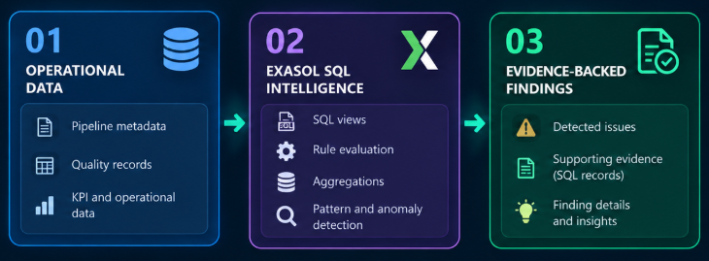
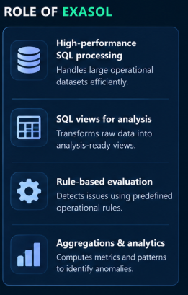
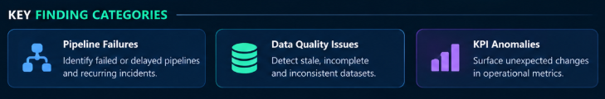
04 / INTELLIGENCE ENGINE AND EXASOL’S ROLE
Exasol Powers the Intelligence Layer
Exasol powers the analytical workflow by evaluating operational rules, identifying anomalies, and providing supporting evidence for detected issues.
CORE TABLES
  OPS_INTEL — the Exasol schema, like a folder that groups related database objects.
  V_FINDINGS — the view name. The V_ prefix commonly stands for View.
05

Slide 6

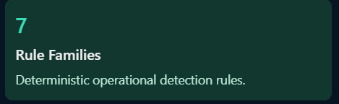
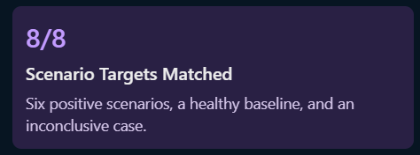
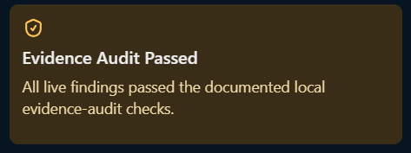
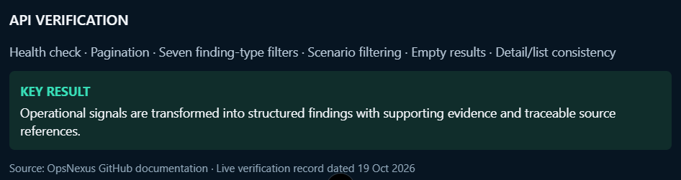
05 / VALIDATION
BUILT TO DETECT. TESTED TO VALIDATE.
Validating analytical rules, database outputs, and evidence-backed findings.
06

Slide 7

06 / IMPACT AND CONCLUSION
FROM OPERATIONAL DATA TO INTELLIGENCE
OpsNexus turns operational signals into structured, evidence-backed findings with Exasol-powered analytics.
01
02
03
04
EARLIER DETECTION
EVIDENCE-DRIVEN
EXASOL ANALYTICS
NEXT STEPS
Surface pipeline, freshness, and data-quality issues.
Show structured findings with traceable source references.
Use SQL views and deterministic rules to evaluate operational data.
Strengthen ingestion, monitoring, and operational integrations.
“Detect the signal. Validate the evidence. Enable better decisions.”
OPSNEXUS • EXASOL HACKATHON 2026 • TRACK 04
12

